Slide 1

Relationships and Health Education

Slide 2
Aim of the session
To update parents’ understanding and knowledge of the delivery of PSHE (personal, social, health & economic) and the element of RHE (relationships and health education) at Hillborough Infant & Nursery School.

Slide 3
Government & PSHE/RHE Guidance
https://www.gov.uk/government/publications/relationships-education-relationships-and-sex-education-rse-and-health-education/relationships-education-primary - link to Gov.uk policy and guidance around this area
https://www.pshe-association.org.uk/system/files/RSE%20roadmap%20FINAL.pdf – document contains links to all relevant information
https://www.pshe-association.org.uk/ - of which the school is a member

Slide 4
By the end of Yr. 2 we aim to achieve these objectives:-
(The following information is taken from our policy and our support providers – PSHE Association & Jigsaw PSHE)
Jigsaw PSHE programme’s health education content
The grid below shows specific health education content for each year group:
Year Group
YR | Naming body parts; family; growing up; responsibilities; making friends, problem solving; being kind, healthy foods and exercise; keeping clean and germs; stranger danger; perseverance; achieving goals; positive attitude; inclusion; differences; bullying; solving problems; compliments; rights and responsibilities; feelings; fears and worries; working with others.
Y1 | Understanding life cycles; body changes from baby to adult, naming parts of the body; family members and relationships; sharing and cooperation, conflict and resolutions; appreciation, community friends and school relationships; types of secrets; fitness challenges; healthy food choices; road safety; dreams and goals; new challenges and overcoming difficulties; working together; celebrating differences; bullying; rights and responsibilities; respect.
Y2 | Life cycles of humans and animals; gender differences; appropriate relationships; identifying members of family and their importance; conflict and resolution; working with peers; appreciation; keeping healthy, understanding how the body works; healthy lifestyle choices; dreams and goals, working alone and in groups successfully; differences and individuality; bullying; hopes and fears; rights and responsibilities; choices and consequences.

Slide 5
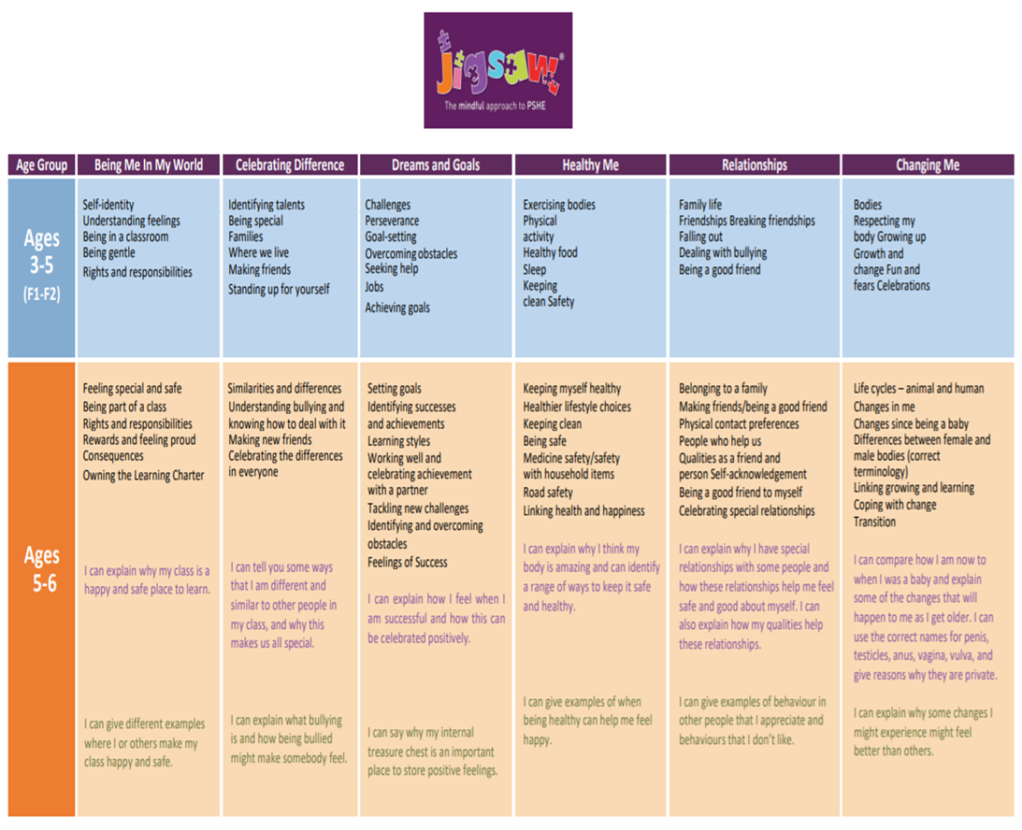
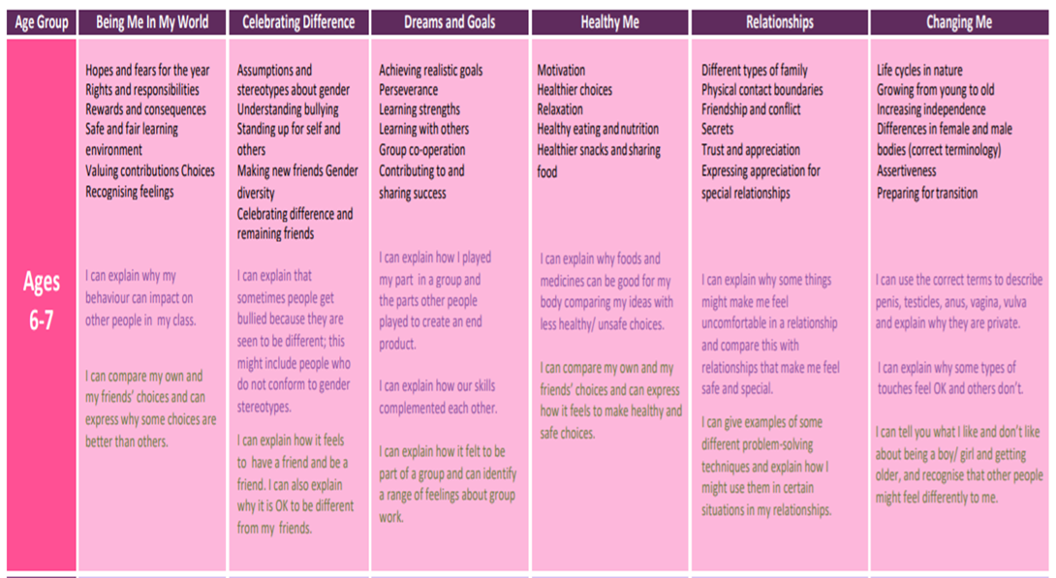
The document below shows the PSHE & RHE curriculum, attainment descriptors and resources.
The school’s planning for each term can be found on the website, under curriculum

Slide 6
Aspects of RHE are already taught through the National Curriculum – the following examples are from the Science curriculum.
We teach the scientific facts in science but our RHE curriculum enhances this to discuss the personal and social aspects of relationships.

Slide 7
So what RHE is covered by the KS1 National Curriculum?
Year 1 Science programme of study
Animals, including humans
Identify, name, draw and label the basic parts of the human body and say which part of the body is associated with each sense.
Year 2 Science programme of study
Animals, including humans
Pupils should be taught to:
Notice that animals, including humans, have offspring which grow into adults They should also be introduced to the processes of reproduction and growth in animals. The focus at this stage should be on questions that help pupils to recognise growth.
The following examples might be used: egg, chick, chicken; egg, caterpillar, pupa, butterfly; spawn, tadpole, frog; lamb, sheep. Growing into adults can include reference to baby, toddler, child, teenager, adult.
Pupils might work scientifically by: observing, through video or first-hand observation and measurement, how different animals, including humans, grow.
Find out about and describe the basic needs of animals, including humans, for survival (water, food and air) and describe the importance for humans of exercise, eating the right amounts of different types of food, and hygiene.

Slide 8
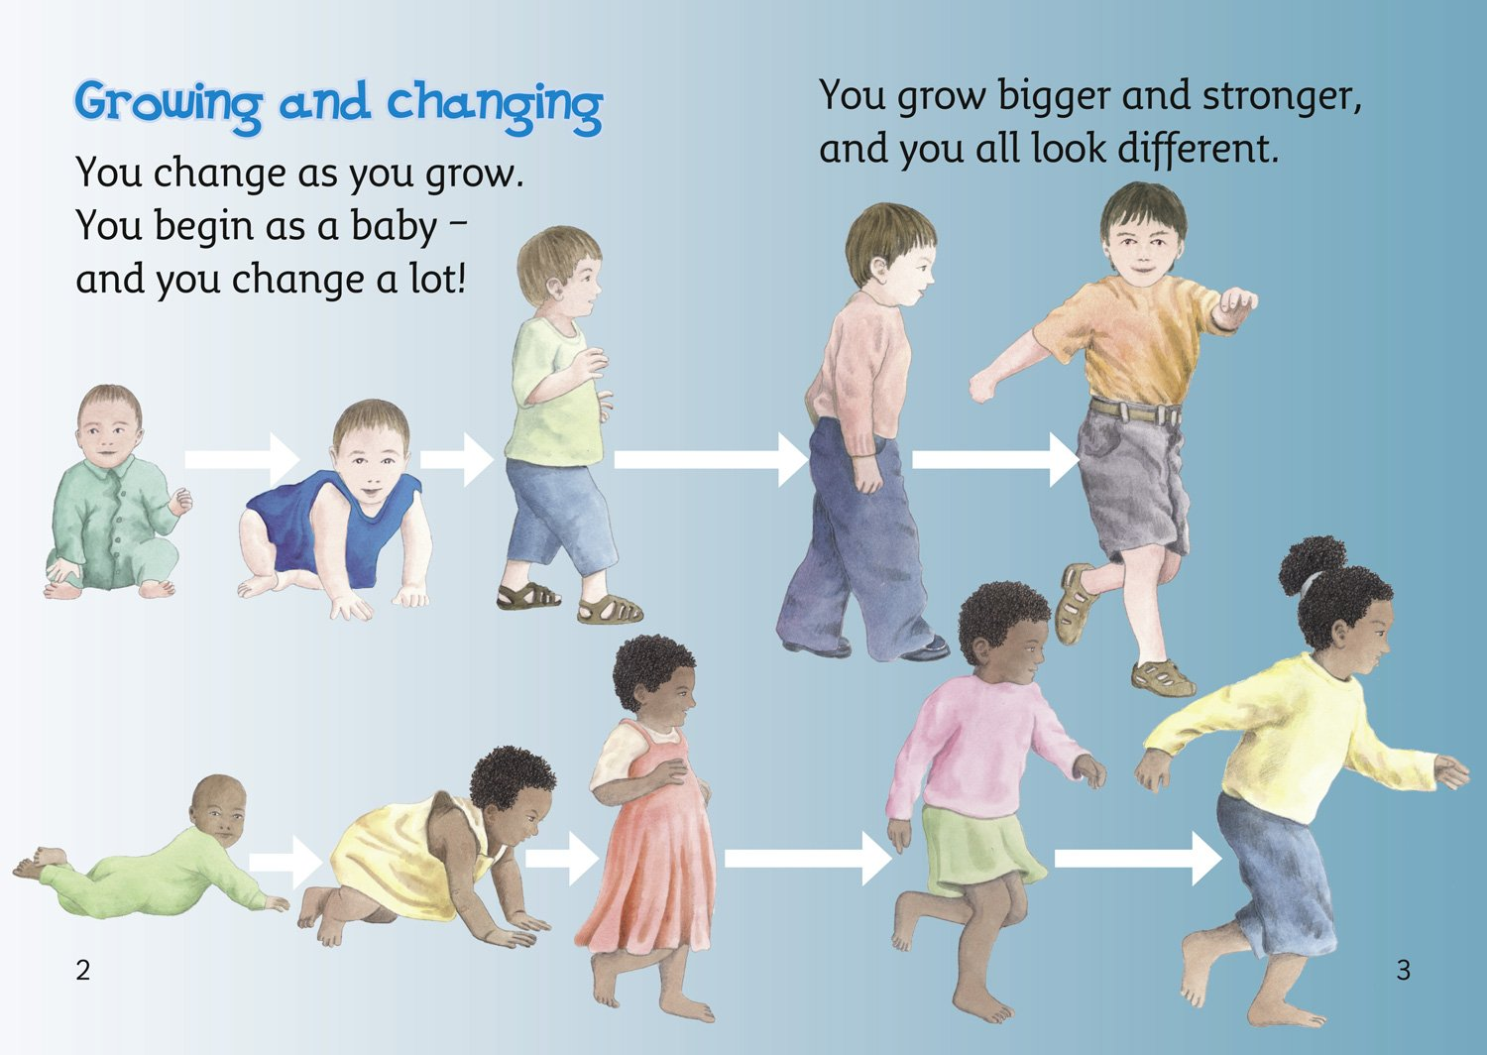
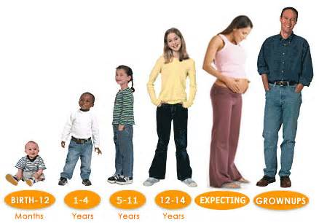
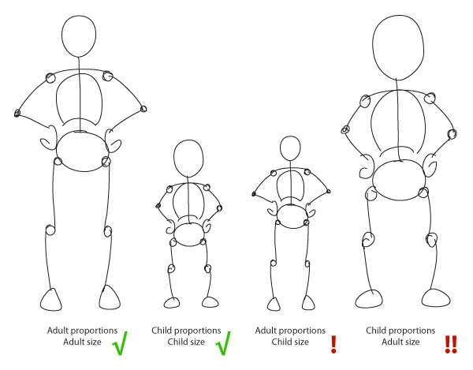
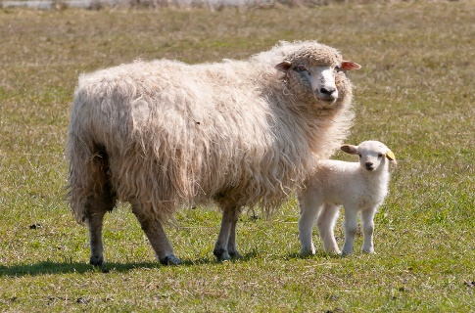
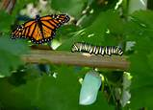
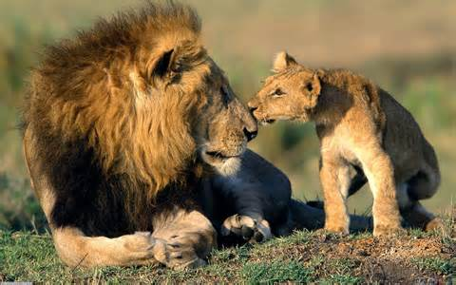


Slide 9
Extract from the National Curriculum
“2.1 Every state-funded school must offer a curriculum which is balanced and broadly based and which:
promotes the spiritual, moral, cultural, mental and physical development of pupils at the school and prepares pupils at the school for the opportunities, responsibilities and experiences of later life.”

Slide 10
Curriculum Facts:
PSHE is taught throughout the year and the school uses Jigsaw PSHE to support this from Nursery to Year 2
RHE Lessons are taught in the summer term – see previous information regarding this area and the links with PSHE

Slide 11
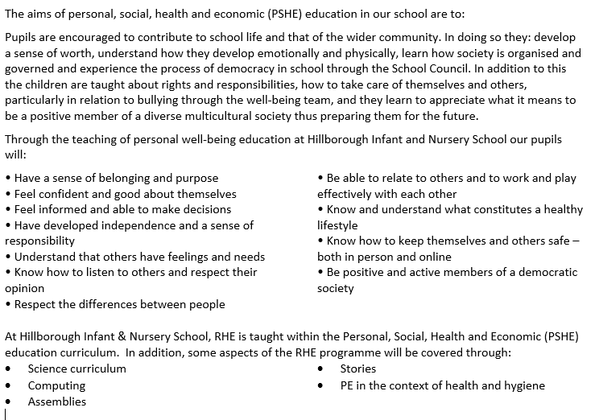
Hillborough Infant and Nursery School policy for PSHE & RHE
Our aims: -

Slide 12
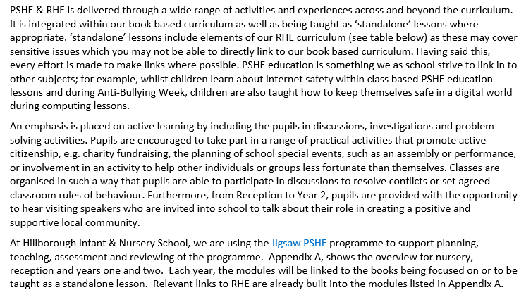
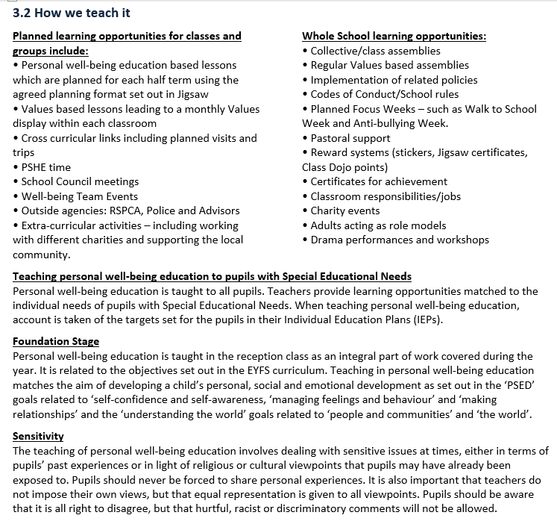
What we will teach and how we will teach it…

Slide 13
Hillborough Infant & Nursery School: -
Is very committed to working with parents around their involvement with PSHE and RHE
We are actively seeking your comments with regard to this presentation and our PSHE & RHE curriculum
We would ask you to follow this link if you have any questions or comment about the PSHE & RHE curriculum - https://forms.gle/sM3J52wS7Kkyxzys5

